Slide 1
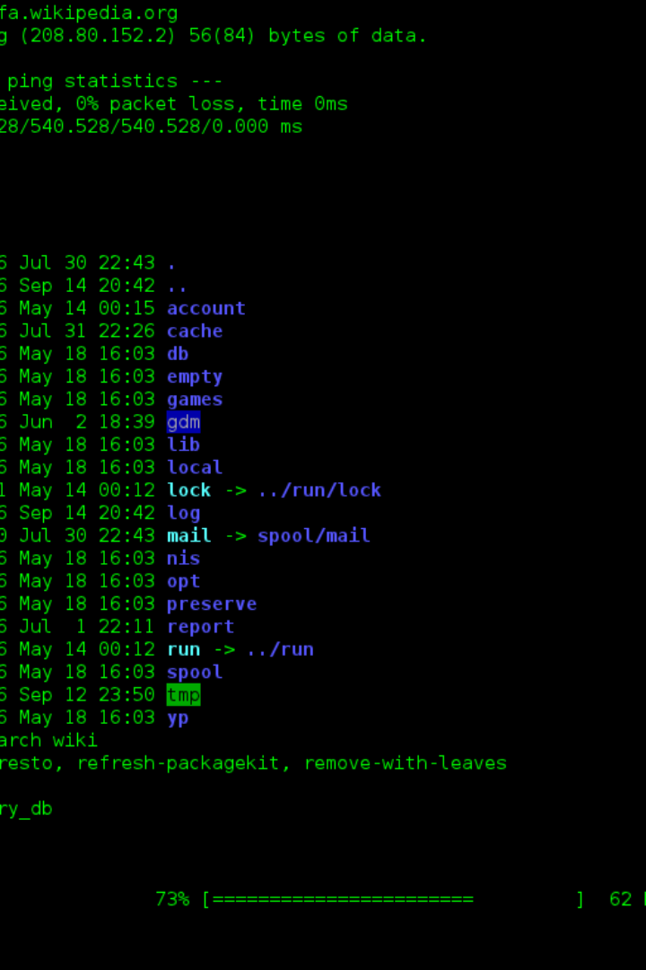


Unix File Permissions: A Beginner's Guide
Understanding Unix file permissions can be daunting. But don't worry, we're here to help!
by Hemanth M

Slide 2
Change File Permissions
Give the owner of a file read, write, or execute permissions with the following commands:
Read:
Write:
Execute:
chmod u+r filename
chmod u+w filename
chmod u+x filename

Slide 3
Change Group Permissions
Give the group of a file read, write, or execute permissions with the following commands:
Read:
Write:
Execute:
chmod g+r filename
chmod g+w filename
chmod g+x filename

Slide 4
Change Other Permissions
Give others read, write, or execute permissions with the following commands:
Read:
Write:
Execute:
chmod o+r filename
chmod o+w filename
chmod o+x filename

Slide 5
Change Permissions for All
Give everyone read, write, or execute permissions with the following commands:
Read:
Write:
Execute:
chmod a+r filename
chmod a+w filename
chmod a+x filename

Slide 6
Symbolic Mode
You can use the ug (owner and group) and o (others) symbols to modify permissions:
1
Add permission:
chmod ug+r filename
Remove permission:
2
chmod o-x filename

Slide 7
Octal Mode
You can also set specific permissions using octal notation:
Read and write for owner, read-only for group and others:
Read, write, and execute for owner, read and execute for group and others:
chmod 644 filename
chmod 755 filename

Slide 8

Recursively Change Permissions for Directories
To change permissions for a directory and its contents recursively:
1
Command:
chmod -R u+w directoryname

Slide 9

Combining Permissions
You can combine permissions in a single command to give the owner read, write, and execute permissions:
1
Command:
chmod u+rwx filename

Slide 10
Linux Process Utilities
Managing and monitoring processes in Linux is easy with these command-line utilities:
ps
top
htop
List all processes:
Monitor system activity in real-time:
Interactive process viewer:
For the current user: ps
Command: htop
On the system: ps aux
Command: top

Slide 11
Kill and Terminate Processes
Stop or control processes with these commands:
kill
killall
pgrep and pkill
Terminate processes by their IDs:
Terminate processes by their names:
Find the PID of a process by name or send signals to processes based on their names:
By PID: kill PID
By name: killall processname
Gracefully with SIGTERM signal: kill -15 PID
Find the PID of a process by name: pgrep processname
Terminate processes by name: pkill processname

Slide 12
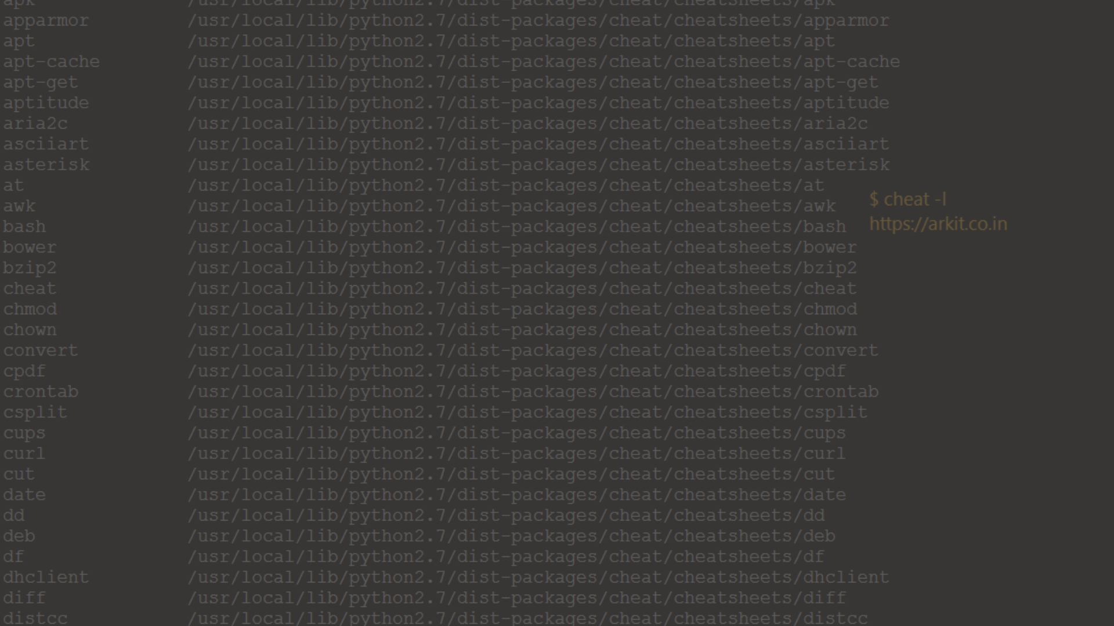
Change Process Priorities
Change the priority of running processes:
1
renice
2
nice
Command to increase the priority of a process with a specific PID:
Command to start a process with a specified priority:
Command: renice -n -5 -p PID
Command to start a command with lower priority: nice -n 10 command

Slide 13
Schedule Future Jobs
Schedule tasks to run at a specific time or when system load permits:
at
batch
Schedule a one-time job:
Schedule a batch job to run when system load is low:
Command and syntax: echo "command" | at 2:30pm
Command and syntax: batch < job_file

Slide 14
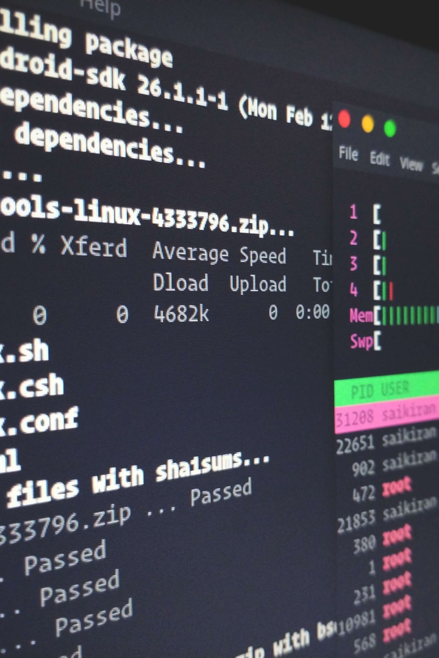
Schedule Recurring Jobs
Use the cron daemon for scheduling recurring tasks:
1
Edit the crontab file:
Command: crontab -e
2
Add the following line to run a script daily at midnight:
0 0 * * * /path/to/script.sh

Slide 15
Disk Space Usage
The df and du utilities help you check disk space usage:
df (Disk Free)
du (Disk Usage)
Displays information about available disk space on mounted filesystems:
Displays the sizes of files and directories and their subdirectories:
Command: df
Command: du

